Slide 1
jpa / hibernate

Slide 2
What is orm?
OOP
ORM
RDB

Slide 3

What is jpa?
An abstraction which specifies the object relational mapping in a Java application.

Slide 4
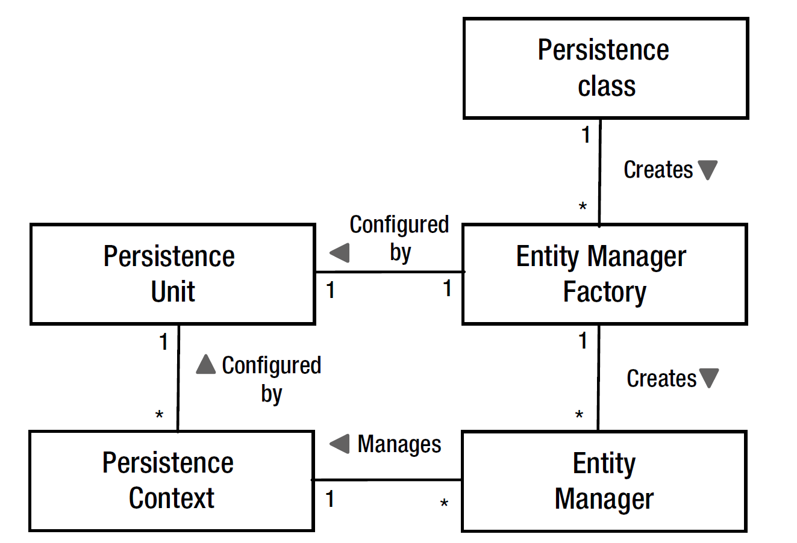
main concepts

Slide 5
entities
A domain concept characterized by individuality which is capable of being changed continuously.
Entities should be always valid.
Invariants are fundamental truths about an entity, so they should always be enforced.

Slide 6
entities
public final class Project { private final UUID id; private final String name; private final Money budget; public Project(UUID id, String name, Money budget) { this.id = id; this.name = name; this.budget = budget; }
// behaviour
@Override public boolean equals(Object o) { if (this == o) return true; if (o == null || getClass() != o.getClass()) return false; Project project = (Project) o; return Objects.equals(id, project.id); } @Override public int hashCode() { return Objects.hash(id); } }

Slide 7
Value objects
A domain object which models a conceptual whole by composing related attributes as an integral unit and measures, quantifies or describes a thing in the domain.
Characteristics
Identity-Less
Immutability
Side-Effect-Free Behavior
Value Equality

Slide 8
Value objects
public final class Money { private final BigDecimal amount; private final String currencyCode; public Money(BigDecimal amount, String currencyCode) { Objects.requireNonNull(amount, "The amount must not be null."); Objects.requireNonNull(currencyCode, "The currencyCode must not be null."); if (amount.signum() <= 0) { throw new IllegalArgumentException("The amount must be positive."); } this.amount = amount; this.currencyCode = currencyCode; } // behaviour @Override public boolean equals(Object o) { if (this == o) return true; if (o == null || getClass() != o.getClass()) return false; Money money = (Money) o; return Objects.equals(amount, money.amount) && Objects.equals(currencyCode, money.currencyCode); } @Override public int hashCode() { return Objects.hash(amount, currencyCode); } }

Slide 9
Entity manager
Container-managed
Application-managed
EntityManagerFactory entityManagerFactory = Persistence.createEntityManagerFactory(“persistence-unit");
EntityManager entityManager = entityManagerFactory.createEntityManager();
entityManager.close();
entityManagerFactory.close();

Slide 10
Entity manager
operations
persist
find
getReference
remove
refresh
detach
merge
flush
clear

Slide 11
mapping
field access
property access (getters)
mixed (@Access)
@Id annotation dictates the access strategy

Slide 12
mapping
Mapping to a table
@Entity @Table(name = "student") // optional - maps to the unqualified class name // if not specified public class Student { }

Slide 13
mapping
Primary key
@Id private UUID id; @Id @GeneratedValue(strategy = GenerationType.IDENTITY) private Long id; @Id @SequenceGenerator(name = "student_seq_gen", sequenceName = "student_seq") @GeneratedValue(strategy = GenerationType.SEQUENCE, generator = "student_seq_gen") private Long id;

Slide 14
mapping
Basic types
@Basic // optional – it’s implicit @Column(name = "NAME") // optional - maps to the attribute name if not specified private String name;

Slide 15
mapping
enum
@Enumerated(EnumType.STRING) private Color color;

Slide 16
mapping
Temporal types
@Temporal(TemporalType.TIMESTAMP) private Date createdOn;

Slide 17
mapping
Large objects
CLOB (Character Large Object)
char[], Character[], String
BLOB (Binary Large Objects)
byte[], Byte[], Serializable
@Lob private byte[]image;

Slide 18
mapping
Transient state
@Transient private long cache;

Slide 19
mapping
Embeddable
@Embeddable
@Access(AccessType.FIELD) public class Money { private BigDecimal amount; private String currencyCode; // equals and hashcode }
@Embeddable public class AccountId implements Serializable { private Long id; // equals and hashcode }

Slide 20
mapping
Embeddable
@EmbeddedId @AttributeOverride(name = "id", column = @Column(name = "ID")) private AccountId id; @Embedded // optional private Money balance;

Slide 21
mapping
Element collections
@ElementCollection @CollectionTable(name = "PERSON_NICKNAME", joinColumns = @JoinColumn(name = "PERSON_ID")) private Set<String> nickNames;
@ElementCollection @AttributeOverrides({ @AttributeOverride(name = "name", column = @Column(name = "NAME")), @AttributeOverride(name = "calories", column = @Column(name = "CALORIES")) }) private Set<Fruit> fruits;

Slide 22
mapping
public class FullName { private final String value; private FullName(String value) { Objects.requireNonNull(value); this.value = value; } public static FullName of(String value) { return new FullName(value); } @Override public String toString() { return value; } }
Attribute converter

Slide 23
mapping
Attribute converter
@Convert(converter = FullNameAttributeConverter.class) private FullName fullName;

Slide 24
mapping
Attribute converter
@Converter class FullNameAttributeConverter implements AttributeConverter<FullName, String> { @Override public String convertToDatabaseColumn(FullName attribute) { return attribute == null ? null : attribute.toString(); } @Override public FullName convertToEntityAttribute(String dbData) { return dbData == null ? null : FullName.of(dbData); } }

Slide 25
relationships
Associations between entities that produce the domain model graph.

Slide 26
relationships
One-to-one unidirectional
@Entity public class Team { @OneToOne @JoinColumn private ProductOwner productOwner; }

Slide 27
relationships
@Entity public class AddressBook { @Id @GeneratedValue(generator = "addressBookIdGenerator") @GenericGenerator(name = "addressBookIdGenerator",
strategy = "foreign", parameters = @Parameter(name = "property",
value = "customer")) private Long customerId; @OneToOne(optional = false) @PrimaryKeyJoinColumn private Customer customer; }
One-to-one bidirectional
@Entity public class Customer { @Id private Long id; @OneToOne(mappedBy = "customer") private AddressBook addressBook; }

Slide 28
relationships
many-to-one unidirectional
@Entity public class Project { @Id private String code; @ManyToOne @JoinColumn(name = "CUSTOMER_ID") private Customer customer; }

Slide 29
relationships
one-to-many bidirectional
@Entity public class Customer { @Id private Long id; @OneToMany(mappedBy = "customer") private Set<Project> projects; }

Slide 30
relationships
one-to-many unidirectional
@Entity public class Customer { @Id private Long id; @OneToMany
@JoinColumn(name = “CUSTOMER_ID") private Set<Project> projects; }

Slide 31
relationships
many-to-many unidirectional
@Entity public class Employee { @Id private String username; @ManyToMany @JoinTable(name = "EMPLOYEE_PROJECT", joinColumns = @JoinColumn(name = "USERNAME"), inverseJoinColumns = @JoinColumn(name = "CODE")) private Set<Project> projects; }

Slide 32
relationships
many-to-many bidirectional
@Entity public class Project { @Id private String code; @ManyToMany(mappedBy = "projects") private Set<Employee> employees; }

Slide 33
Cascading operations
CascadeType.PERSIST
CascadeType.REFRESH
CascadeType.REMOVE
CascadeType.MERGE
CascadeType.DETACH
Orphan removal
@OneToOne(orphanRemoval = true)
@OneToMany(orphanRemoval = true)
NOTE: don’t use when the orphan entity is referenced from multiple entities.
NOTE: Consider using ON DELETE CASCADE

Slide 34
Collection types
set
@Entity public class User { @Id private String username; @ElementCollection @Enumerated(EnumType.STRING)
@Column(nullable = false) private Set<Permission> permissions; enum Permission { READ, WRITE } }

Slide 35
Collection types
Bag
@Entity public class Item { @Id private Long id; @ElementCollection @CollectionId(columns = @Column(name = "IMAGE_ID"), type = @Type(type = "long"), generator = "identity") private Collection<String> images; }

Slide 36
Collection types
map
@Entity public class Project { @Id private String project; @ElementCollection @MapKeyColumn(name = "YEAR_MONTH") @MapKeyTemporal(TemporalType.DATE) private Map<Date, Money> costs; }

Slide 37
Collection types
Sorting and ordering
@org.hibernate.annotations.SortComparator
@org.hibernate.annotations.SortNatural
@javax.persistence.OrderBy
@org.hibernate.annotations.OrderBy

Slide 38
inheritance
Table per concrete class
@Entity @Inheritance(strategy = InheritanceType.TABLE_PER_CLASS) public abstract class Project { @Id private String code; }
@Entity public class InternalProject extends Project { private Money budget; }
@Entity public class CommercialProject extends Project { }

Slide 39
inheritance
Single Table
@Entity @Inheritance(strategy = InheritanceType.SINGLE_TABLE) @DiscriminatorColumn(name = "TYPE") public abstract class Employee { @Id private String username; }
@Entity @DiscriminatorValue("CONTRACT") public class ContractEmployee extends Employee { }
@Entity @DiscriminatorValue("FULL_TIME") public class FullTimeEmployee extends Employee { }

Slide 40
inheritance
joined
@Entity @Inheritance(strategy = InheritanceType.JOINED) public abstract class Vehicle { @Id private Long id; }
@Entity public class Car extends Vehicle { }
@Entity public class Truck extends Vehicle { }

Slide 41
inheritance
No polymorphism
@MappedSuperclass public abstract class Address { private String street; }
@Embeddable @AttributeOverride(name = "street", column = @Column(name = "HOME_ADDRESS_STREET")) public class HomeAddress extends Address { private Integer number; }
@Embeddable @AttributeOverride(name = "street", column = @Column(name = "WORK_ADDRESS_STREET")) public class WorkAddress extends Address { private String fax; }

Slide 42
Transaction management
JTA
Resource-Local
javax.persistence.EntityTransaction
EntityTransaction transaction = entityManager.getTransaction();
transaction.begin();
//
transaction.commit();

Slide 43
JPQL / HQL
javax.persistence.Query
javax.persistence.TypedQuery
org.hibernate.query.Query
Query query = entityManager.createQuery(“select p from Project p”);
TypedQuery query = entityManager.createQuery(“select p from Project p”, Project.class);
Query query = entityManager.unwrap(Session.class).createQuery(“select p from Project p”);

Slide 44
JPQL/HQL
Aggregate functions
COUNT
AVG
MIN
MAX
SUM

Slide 45
JPQL/HQL
functions
CONCAT
SUBSTRING
UPPER
LOWER
TRIM
LENGTH
ABS
MOD
SQRT
CURRENT_DATE
CURRENT_TIME
CURRENT_TIMESTAMP
EXTRACT
YEAR
MONTH
DAY
HOUR
MINUTE
SECOND

Slide 46
JPQL/HQL
Collection expressions
SIZE
MAXELEMENT
MAXINDEX
MINELEMENT
MININDEX
ELEMENTS
INDICES

Slide 47
Criteria api
javax.persistence.criteria.CriteriaQuery
javax.persistence.criteria.CriteriaBuilder
CriteriaBuilder builder = entityManager.getCriteriaBuilder();
CriteriaQuery<Person> criteria = builder.createQuery(Person.class);

Slide 48
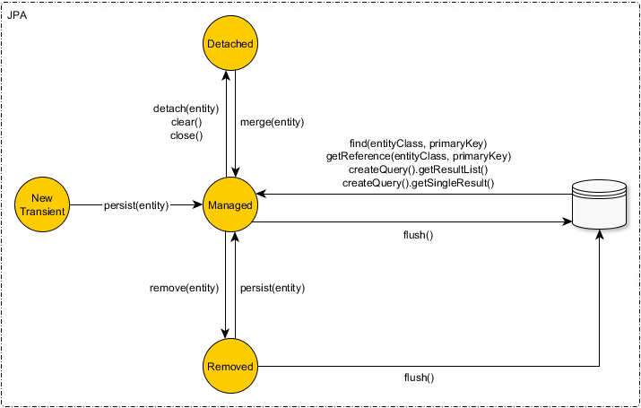
entity state transitions

Slide 49
Lazy loading
Aims to defer initialization of an object until the point at which is needed.
Proxy (javaassist, ByteBuddy) – non collection types
Specialized collections – collection types
PersistentBag
PersistentList
PersistentSet
PersistentMap

Slide 50
Unit of work
Maintains a list of objects affected by a business transaction and coordinates the writing out of changes and resolution of concurrency problems.
Synchronization is delayed, therefore minimizing the row-level lock interval, associated with every database write operation
Enables JDBC batching

Slide 51
flushing
JPA flush mode types
FlushModeType.AUTO
FlushModeType.COMMIT
Hibernate flush mode types
FlushMode.AUTO
FlushMode.ALWAYS
FlushMode.COMMIT
FlushMode.MANUAL
Triggering before query – prevents the read-your-own-writes consistency issue
Triggering before commit – ensures the durability of the in-memory changes

Slide 52
Flushing (AUTO mode)
JPA flushes always before native SQL and before JPQL when entities overlap with managed
org.hibernate.NativeQuery#setHibernateFlushMode(FlushMode flushMode) FlushMode.ALWAYS
org.hibernate.NativeQuery#addSynchronizedEntityClass(Class entityClass)
@Synchronize

Slide 53
Dirty checking
The process of identification of modified entities

Slide 54
Identity map
Ensures that each object gets loaded only once by keeping every loaded object in a map.
Prevents the situation where two in-memory object which correspond to a single database record might be inconsistently modified.
Prevents non-repeatable read phenomena.

Slide 55
Composite keys
Id class
@Entity @IdClass(User.UserId.class) public class User { @Id private Long tenantId; @Id private String username; public static class UserId implements Serializable { private Long tenantId; private String username; // constructors, equals & hashCode } }

Slide 56
Composite keys
Embedded id class
@Entity public class User { @EmbeddedId private UserId userId; @Embeddable public static class UserId implements Serializable { private Long tenantId; private String username; // constructors //equals & hashCode } }

Slide 57
business keys
@Entity public class Project { @Id @GeneratedValue private Long id; @NaturalId private String code; //constructors, equals & hashCode }
Optional<Project> project = entityManager.unwrap(Session.clas)
.bySimpleNaturalId(Project.class)
.loadOptional(“IFG01”);

Slide 58
Generated types
@Generated
@GeneratorType
@CreationTimestamp
@UpdateTimestamp

Slide 59
Useful annotations
@Where
@WhereJoinTable
@SQLDelete
@SQLInsert
@SQLUpdate
@Formula
@Loader

Slide 60
Concurrency control
Optimistic locking
Pessimistic locking

Slide 61
THANK YOU
Stanislav dobrovolschi

